Slide 1

GA Ecommerce Take Home Analysis
Drew Pritchard

Slide 2
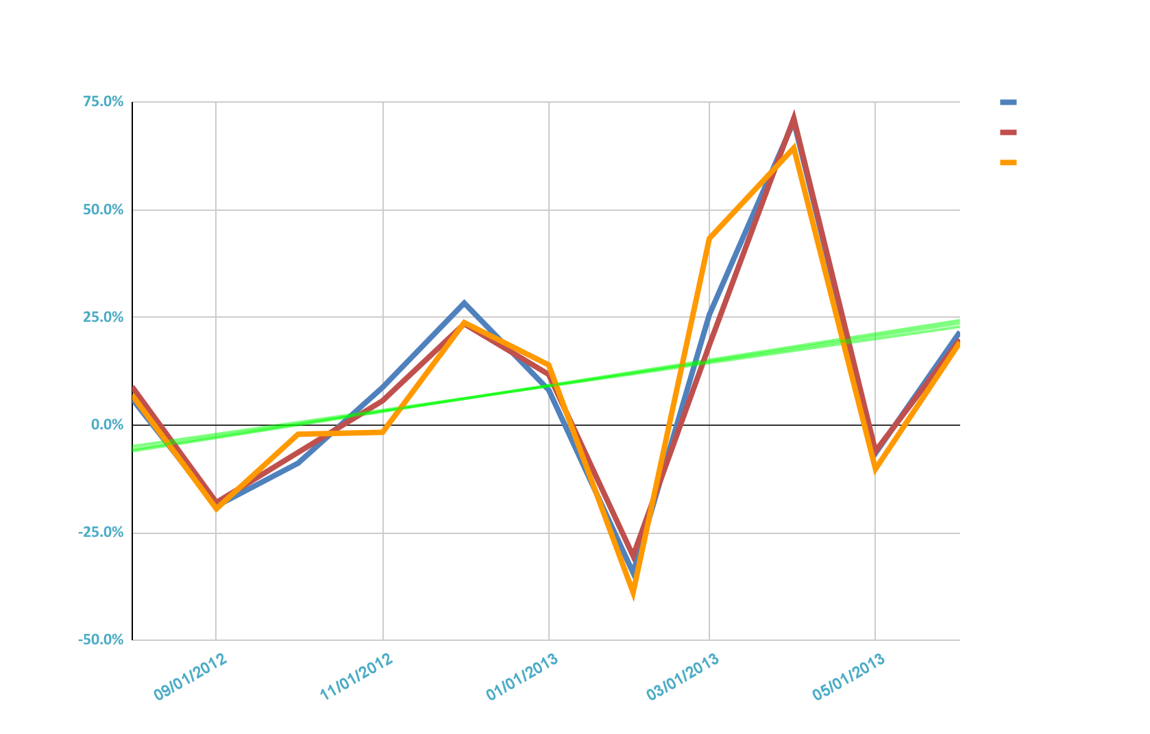
MoM % Changes - The Good
Steady month over month growth in transactions, sessions, and quantity
All growing at similar rates: Average 10% MoM

Slide 3
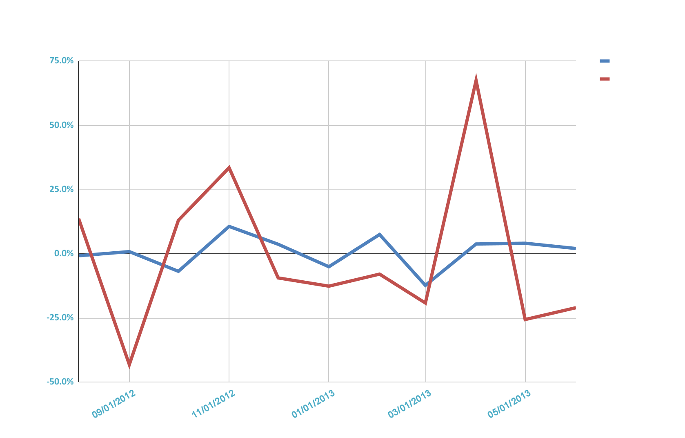
MoM % Changes - The Bad
No growth in Adds to Cart decrease in ECR despite other growth
Next we dive into the drivers in this decrease
Mean growth
AtC: 0%
ECR: -1%

Slide 4
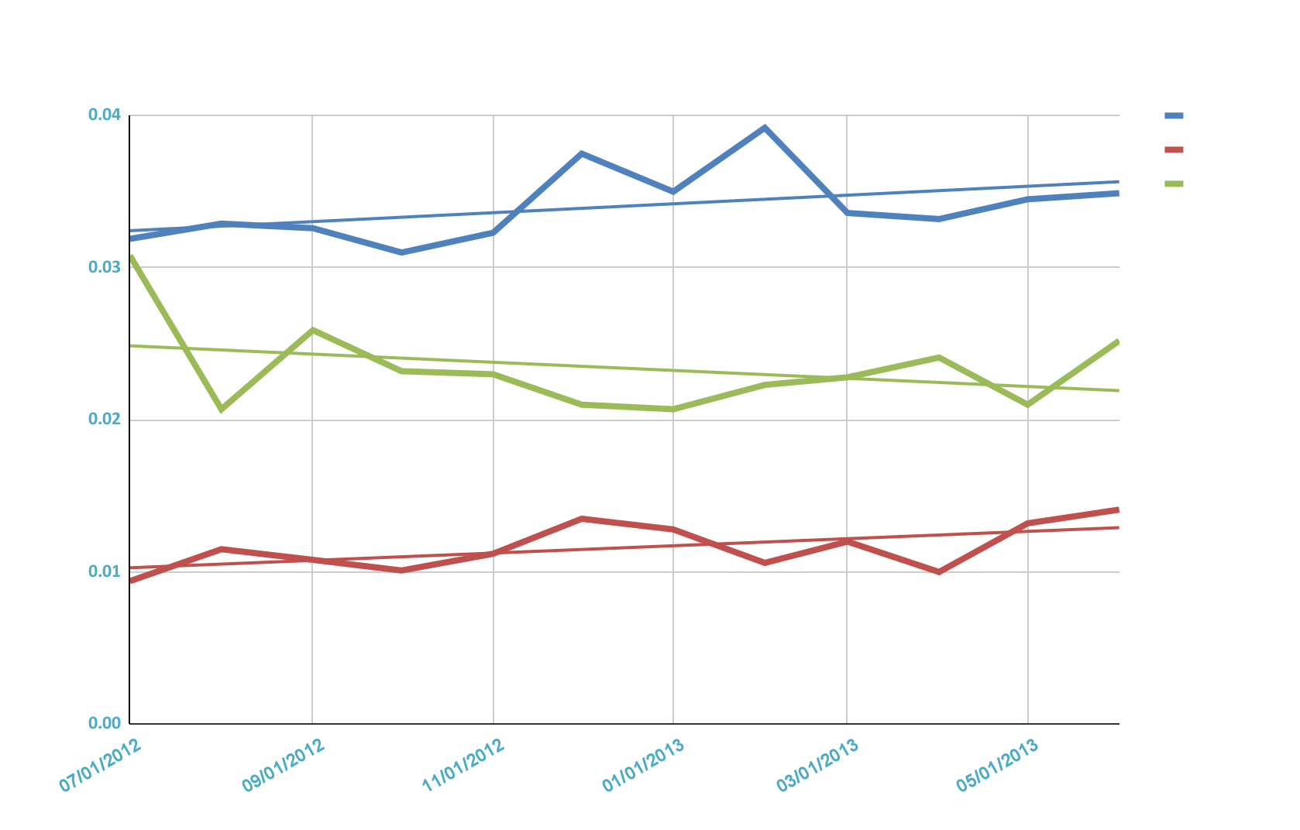
ECR by Device
Tablet ECR is trending down
Possible issue with conversions
!!!

Slide 5
Conclusions
Insight: A low conversion rate on tablet users is driving an overall decrease in ECR
Next Steps:
Identify touchpoint(s) on tablet with highest drop rate
Increase efforts to increase conversions on tablet platform
Revisit in 2 months to measure complete YoY analysis

